Slide 1
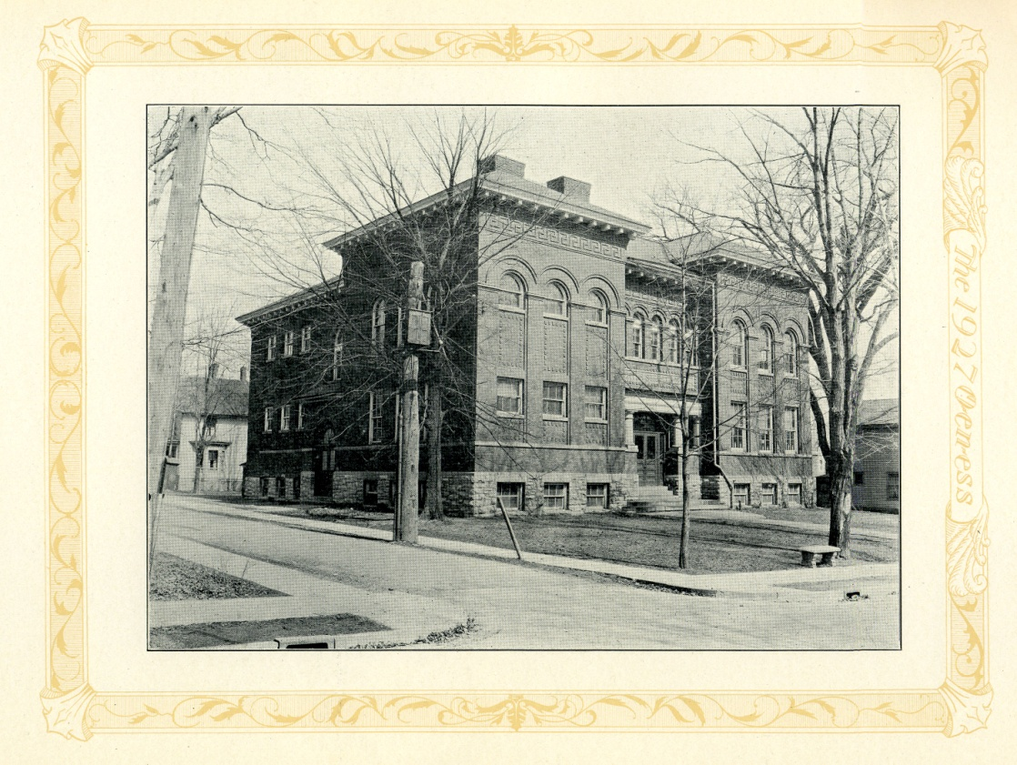
The History of Center Street School
Created by the 2009-2010 4th grade library class

Slide 2
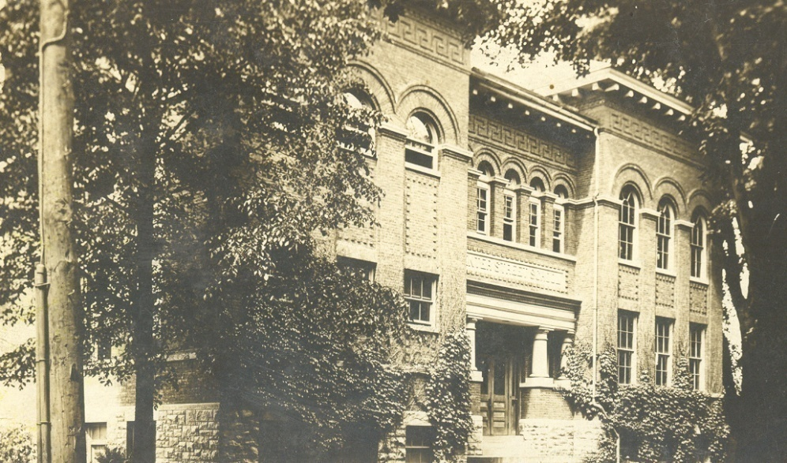
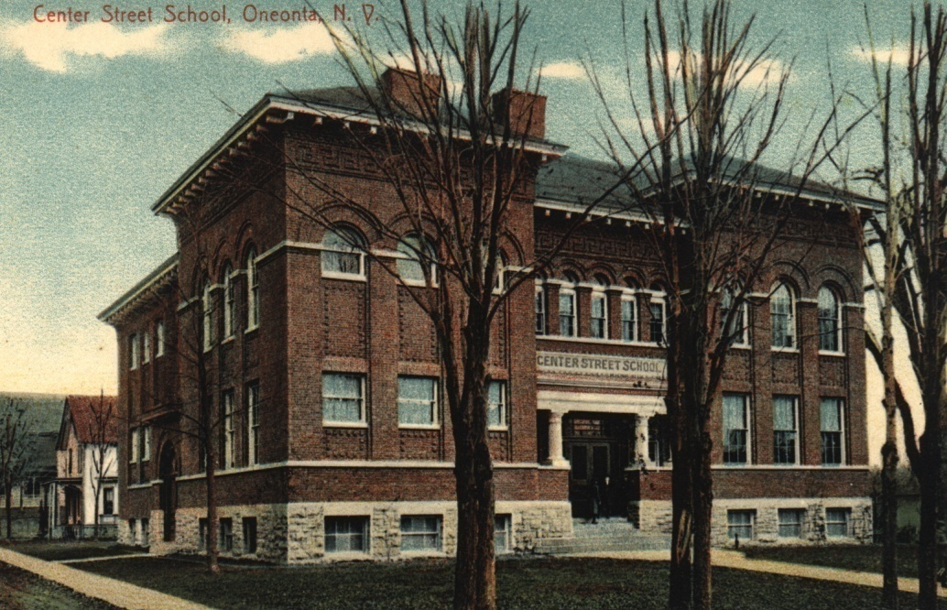
In April 1897 the village of Oneonta voted in favor of purchasing the land on the corner of Center Street and Central Avenue for the purpose of building a new school. Construction of the new school began on June 2nd, and remarkably - in less than five months - Center Street School was open for the first day of classes on October 25th 1897.

Slide 3
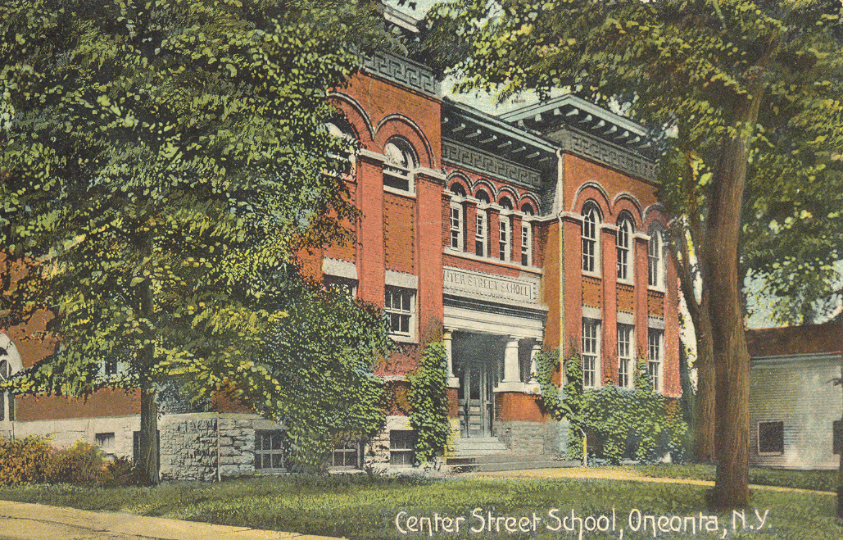
Center Street School looked very different when it was built 114 years ago.
For example, it was surrounded by many trees which have since been
removed, three houses stood where the 1960 addition now stands, the front
of the school was often covered in green ivy, and the main entrance of the
School (between the pillars) featured double doors and steps which have since
been removed.

Slide 4
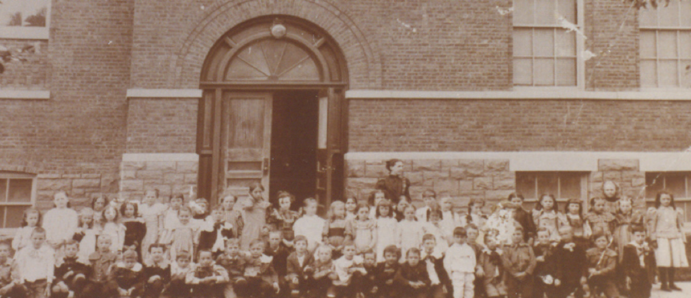
During this era, or period in time, it was typical for school principals to be
women. Center Street’s first principal was Linda Mead. It was also common
for class sizes to be very high. Pictured below is one 2nd grade class from
1898 made up of 60 students! This picture was taken outside the Central
Avenue entrance. Notice the ornate, or fancy, window above the entrance, long
since replaced by the awning which is there today.

Slide 5
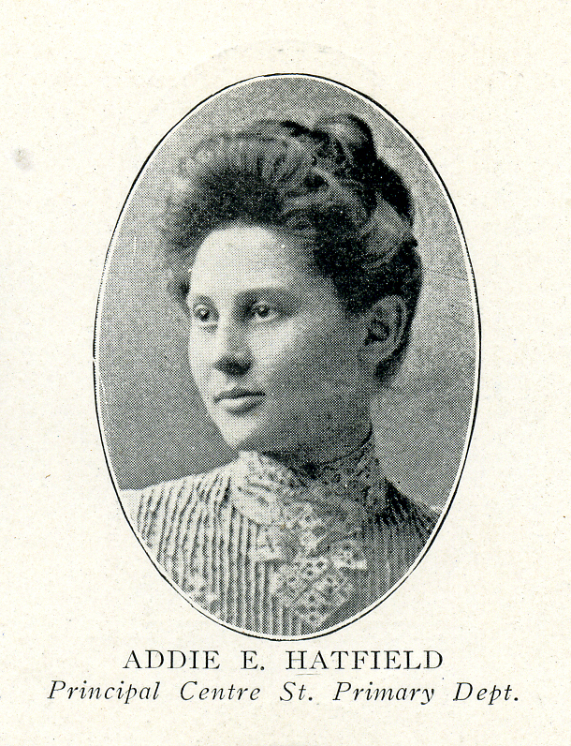
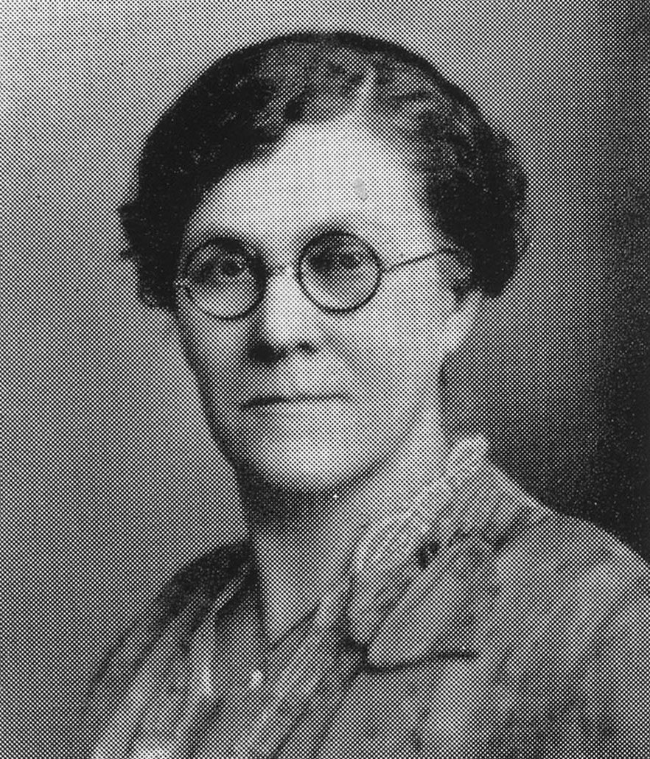
Principal & teacher Estella Matteson
In 1906 Center Street School also became a teacher training school as part of
the Oneonta State Normal School, which would later become the State
University College at Oneonta. Now teachers had to teach student teachers as
well as students. The new principal in 1906 was young Addie Hatfield, who was
later replaced by Estella Matteson, who also taught, from 1914-1933.

Slide 6
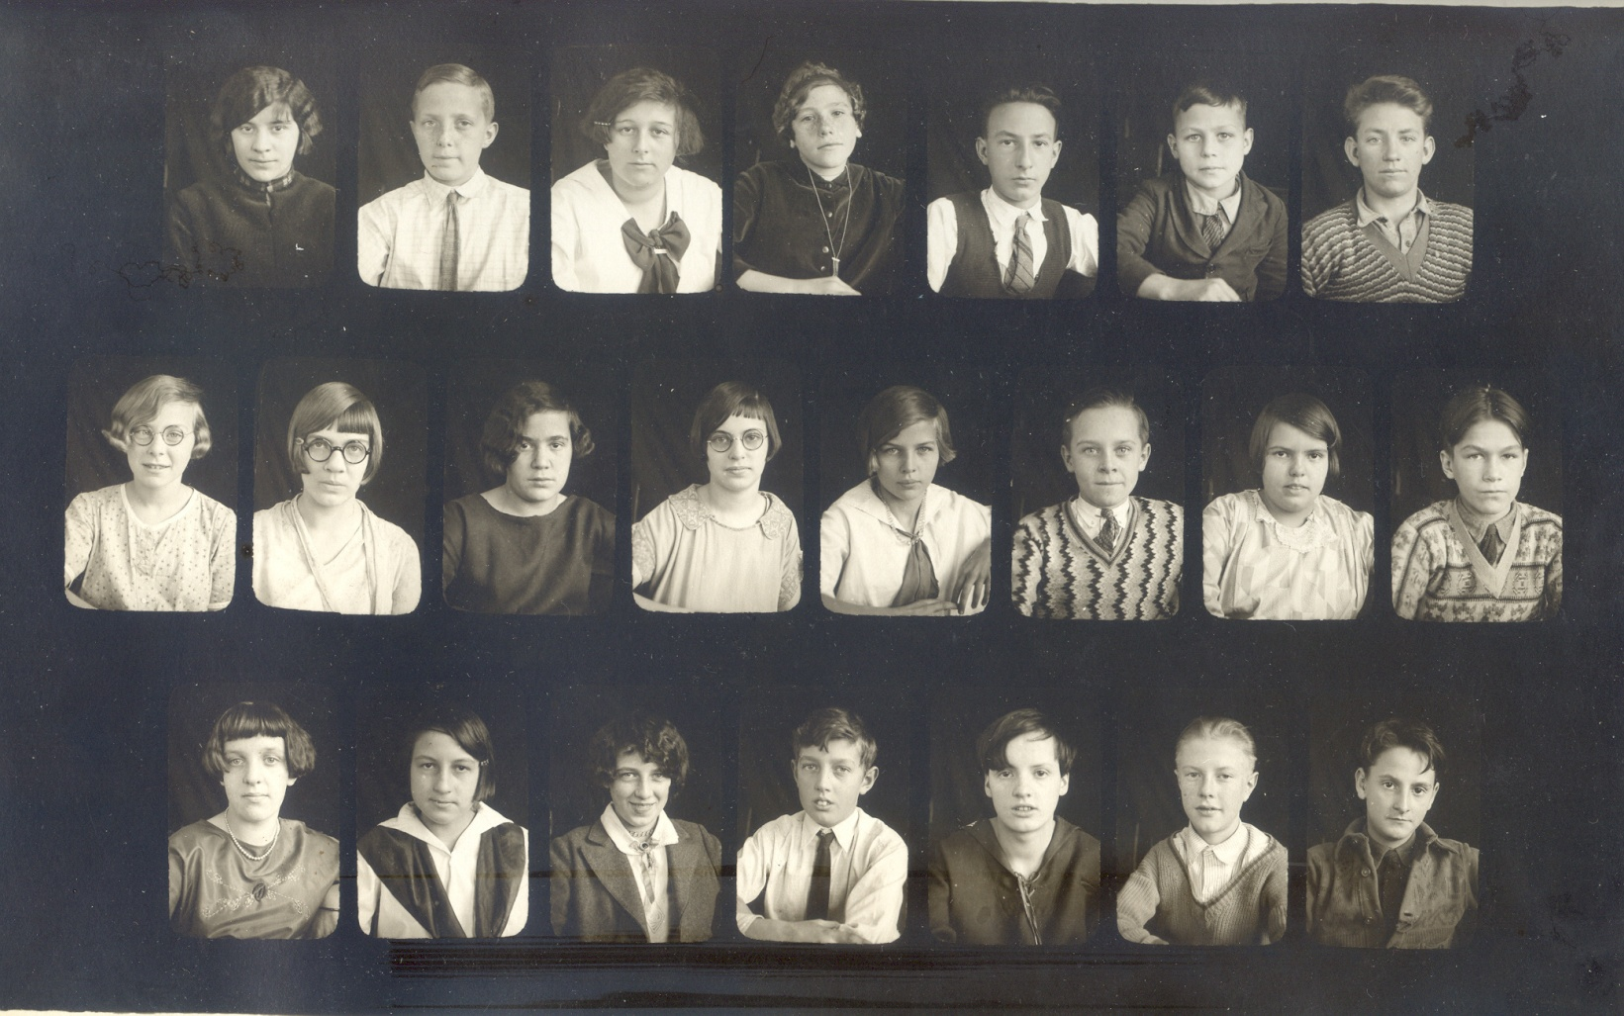
Pictured below is a class from 1927. During this era, all Center Street School
students walked to school as there were no buses, would walk back home for
lunch as there was also no cafeteria, then would walk back to school for
afternoon classes, and at the end of the school day walk themselves back
home again!

Slide 7
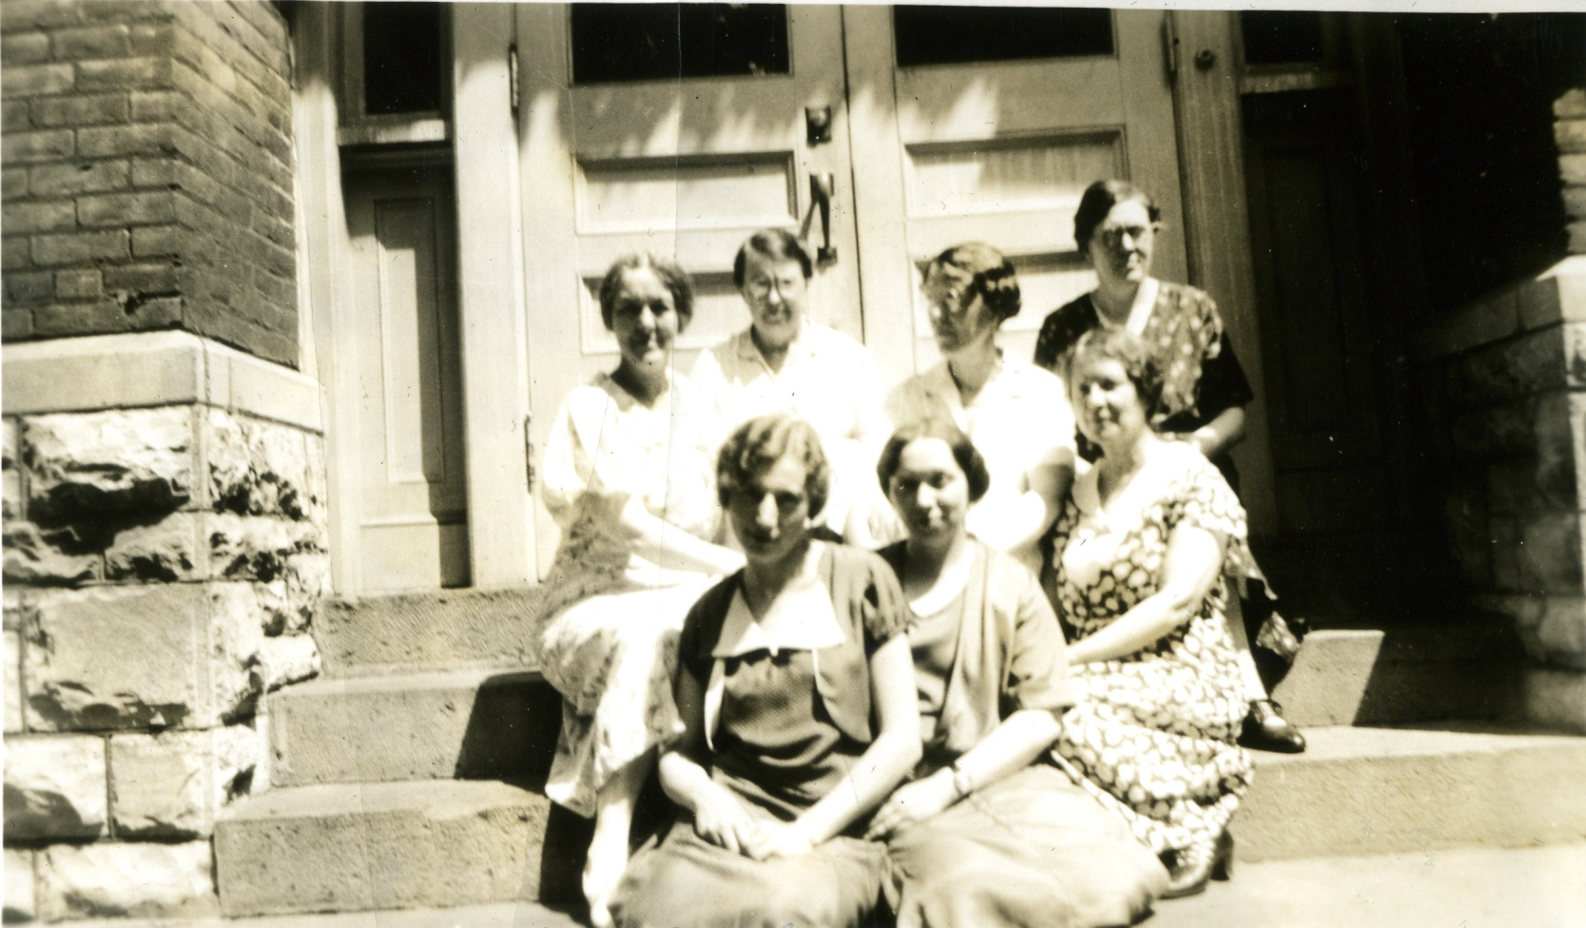
“The Old Gang,” 1916-1933
In 1933 Bugbee School was built and Center Street School was no longer a
teacher training school. “The Old Gang,” a group of seven women who were
the entire teaching staff at Center Street School for 17 years, all retired and
were replaced by an entirely new staff of teachers led by 3rd grade teacher
and new principal Ava Hall.

Slide 8
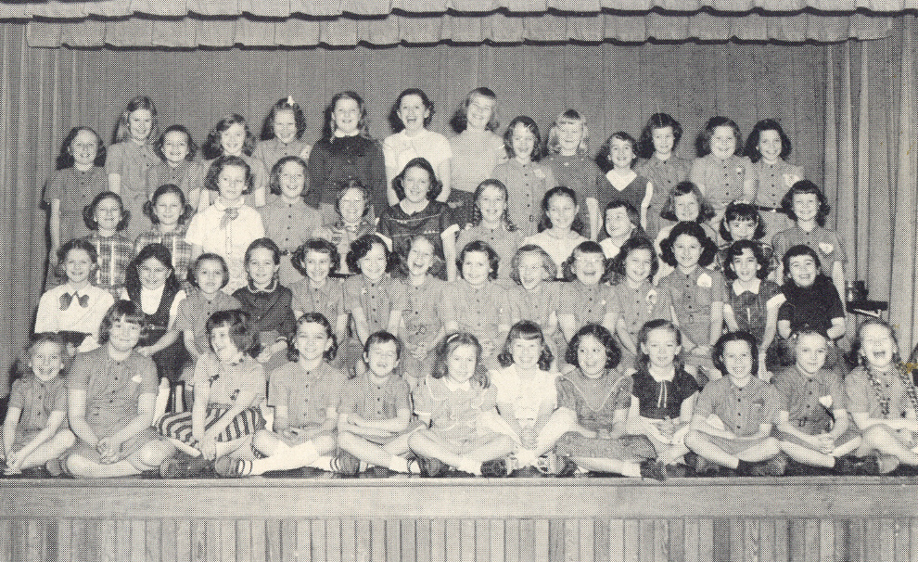
During Ava Hall's 20 years as principal at Center Street School, she was also a
popular 3rd grade teacher, although a visit to her principal's office often
resulted in being rapped on the knuckles by her ruler! This time period saw a
growing increase in student enrollment, which peaked in the 1950's with 350
students. Assembly programs once held in the 3rd floor auditorium were
moved to a stairwell area as the 3rd floor was converted to classroom space,
and music classes as well as physical education were held in the basement
boiler room!
3rd floor auditorium in 1954, where classrooms now reside.

Slide 9
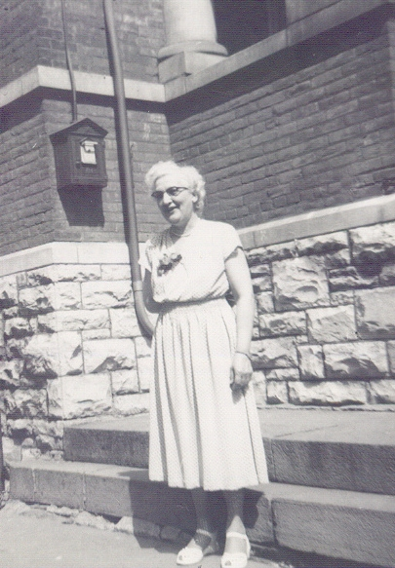
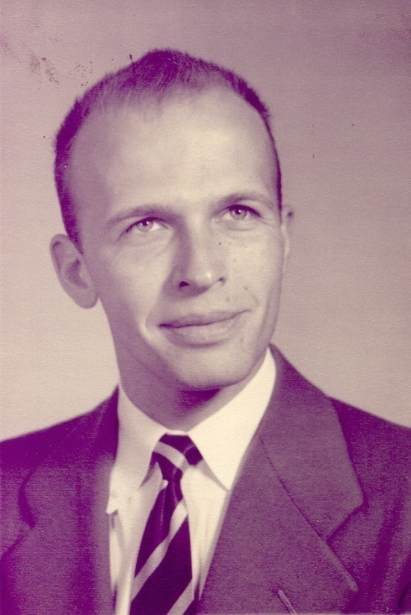
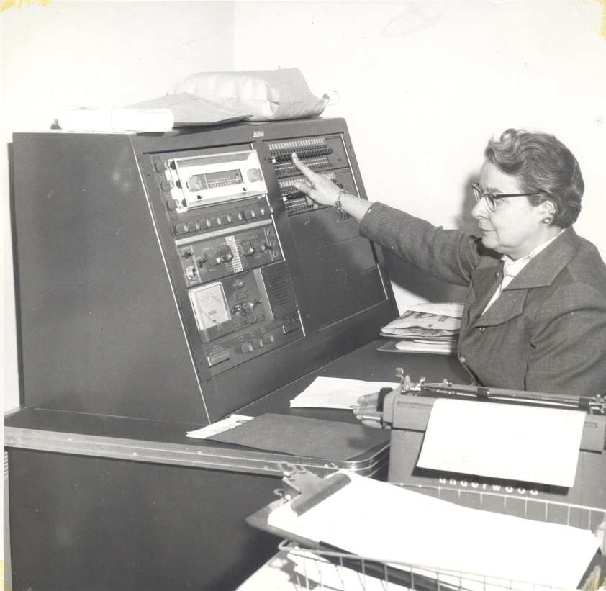
Ava Hall retired in 1953, to be replaced by Erle Smith, the first man to ever be
named an elementary school principal in Oneonta. He became known for
teaching dance lessons to the 6th graders every Friday. Two years later, longtime
1st grade teacher Lucile Houck became principal, and would remain so for almost
20 years. Known for being short but stern, Houck ultimately worked as a teacher
and principal at Center Street School from 1933-1972 - that's almost 40 years!

Slide 10
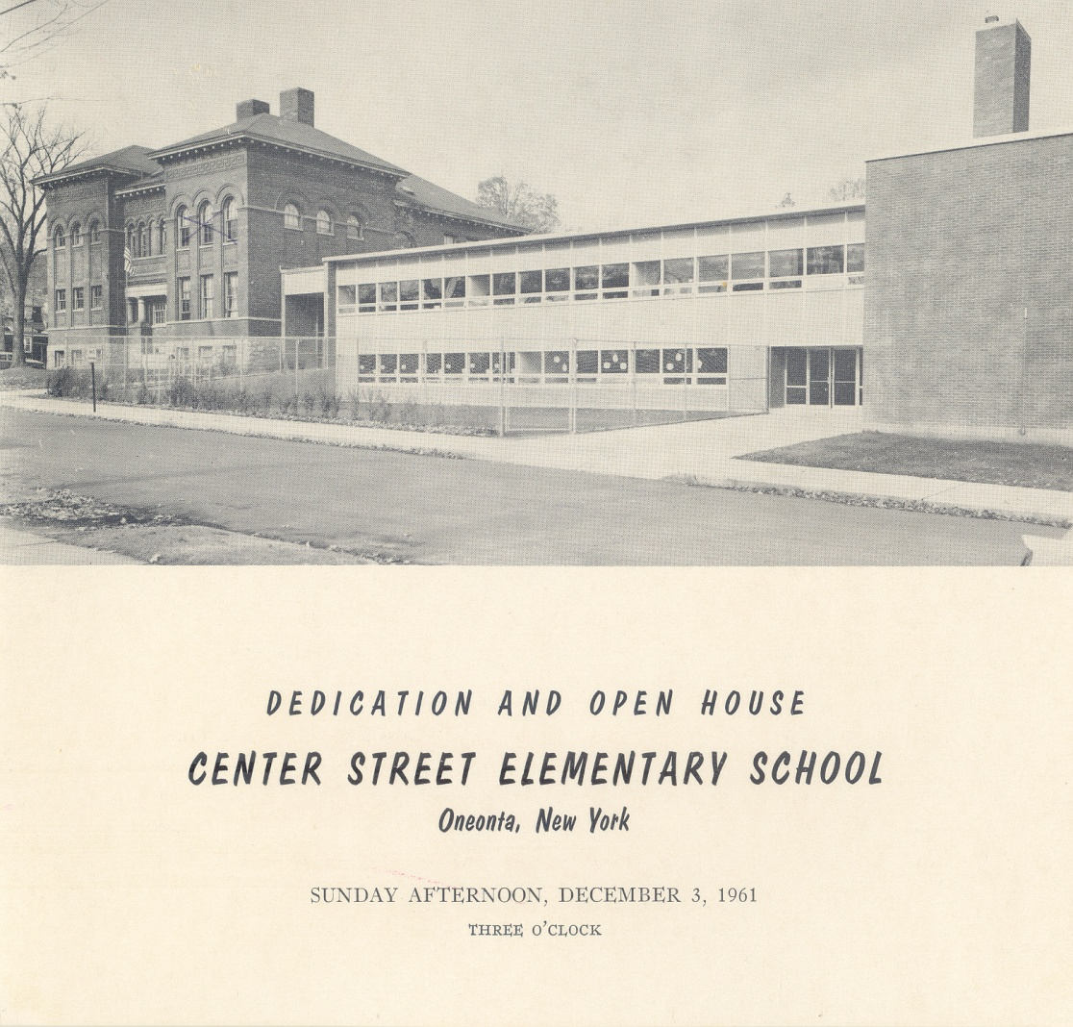
To accommodate rising student enrollment, work began in 1960 on a new addition
to Center Street School. The new building would provide extra classrooms, a
library, a cafeteria kitchen, gymnasium, and main office. On December 3rd, 1961,
a ceremony was held to celebrate the newly renovated Center Street School, and
a time capsule was buried behind the 1960 cornerstone...

Slide 11
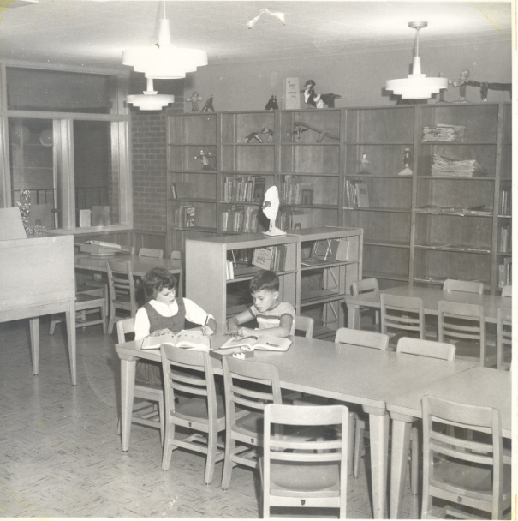
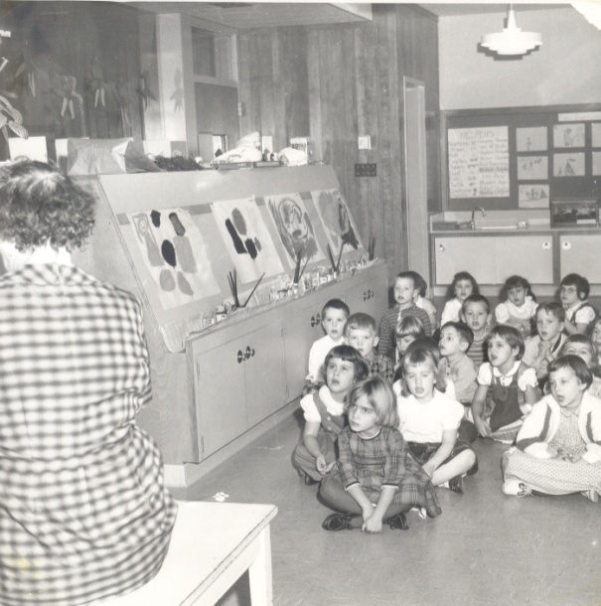
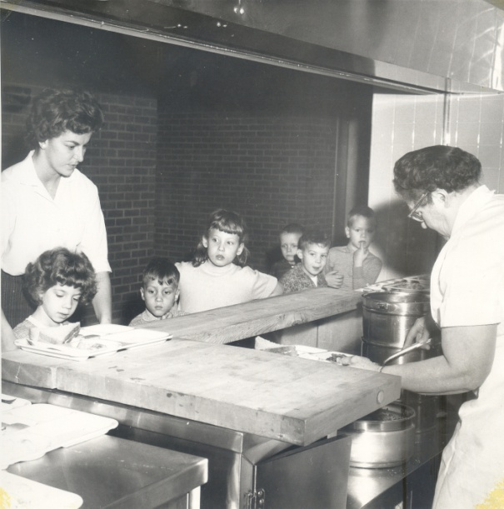
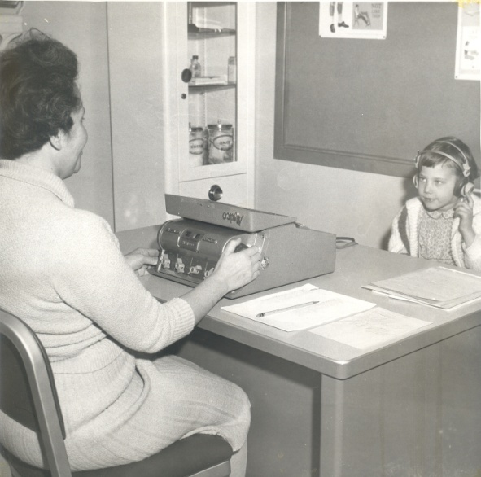
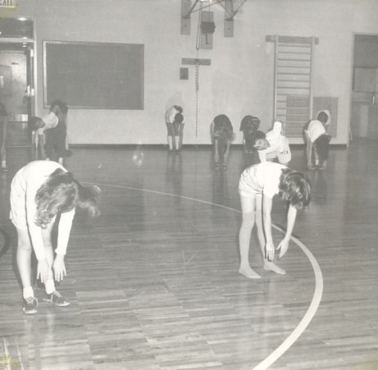
Look around the Oneonta
community – even your own
neighborhood - and you
may find many former Center
Street School teachers and
students who remember
how exciting it was when the
new, 1960 addition was
completed. Look at these
photos – do you recognize
where they were taken? And
do they look the same,
similar, or different today?

Slide 12
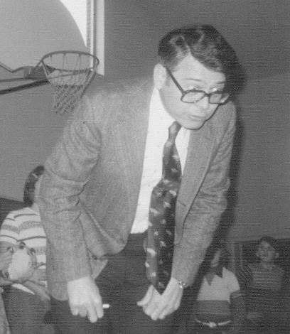
During the 1970's Dick Picolla, then Dorothy Perry, served as principal during a
time when student enrollment began to drop. Attempts were made to close
down the school, but the neighborhood community fought these attempts and
Center Street School persevered. The attempts even continued into the 1980's.

Slide 13
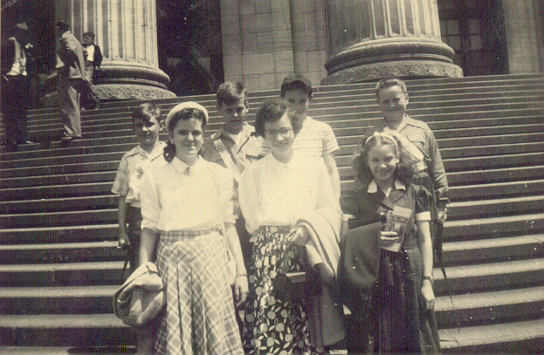
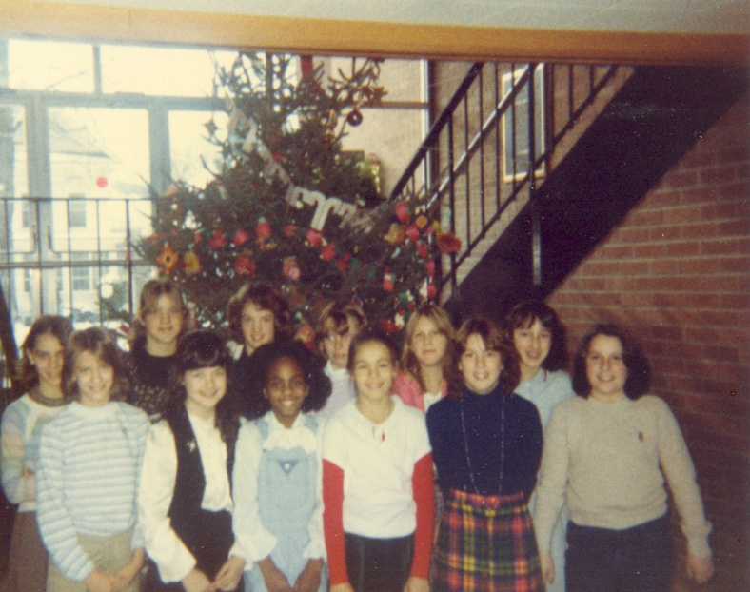
Over the past 114 years, many traditions at Center Street School have
survived, while others have faded into history. For example, students today
serve on Safety Patrol and take a year-end trip to Washington, D.C. This
tradition began in the 1930’s, with Safety Patrolers visiting the state capital in
Albany every May. Traditions which have long since vanished: starting each
school day with a bible reading, or the Lord’s prayer, and the school-wide
decorating of a Christmas tree in the foyer of the 1960 building.
Safety Patrol trip to Albany in 1950
Celebrating Christmas in 1981

Slide 14
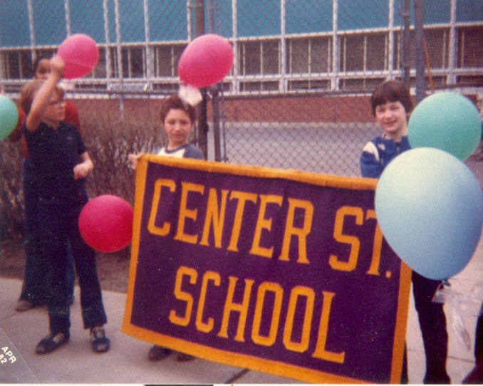
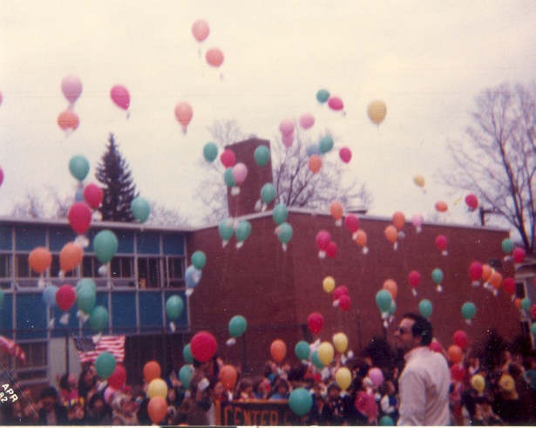
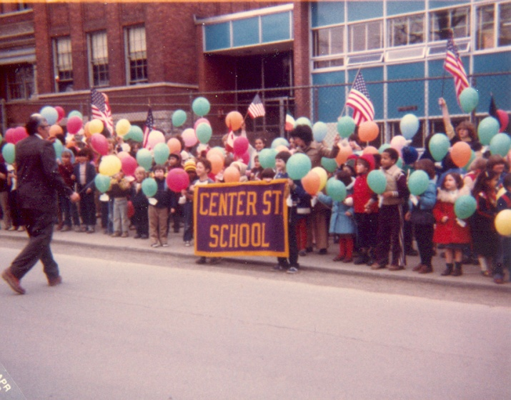
Mr. John Cook was hired in 1983 as the new Center Street School principal.
Over the next 26 years he would help to oversee both the 90th anniversary
celebration of the school in 1985, as well as the 100th in 1995; a yearlong
renovation between 1989-1990 to remove asbestos from the 1897
building; the fundraising for and building of several new school
playgrounds; and integration of computer technology into the classrooms.

Slide 15
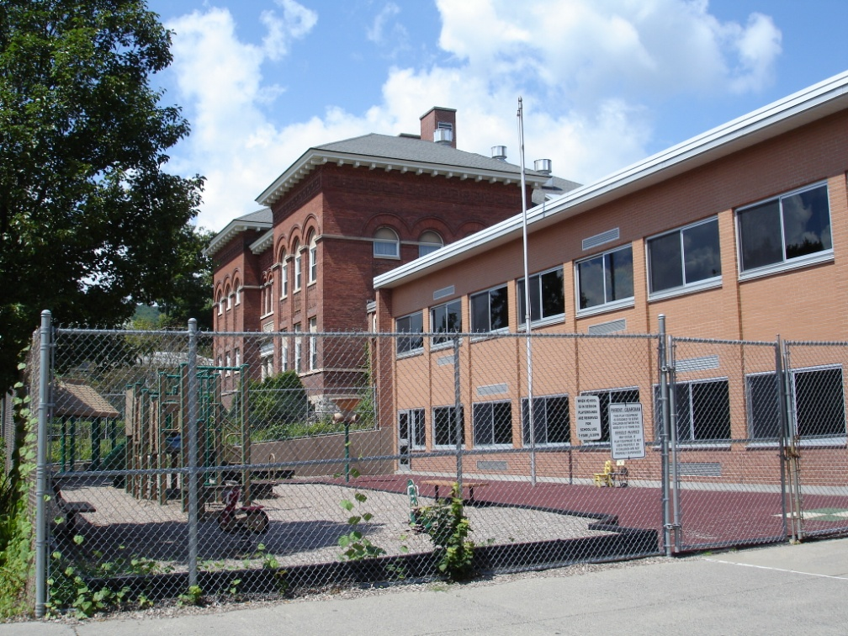
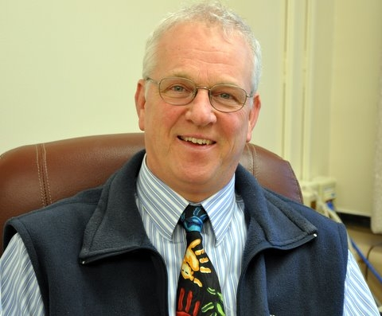
When Mr. Cook retired in 2010 after a remarkable 26 years as principal at our school, a new chapter in the story of Center Street School began with new principal Mrs. Coleen Lewis. This is an exciting time in the history of Center Street School: the 1897 building is celebrating its 114th year, and the 1960 building recently turned 50 years old and the time capsule was opened! Center Street School is the longest serving school in the history of Oneonta. It is a great place to learn, work, and play - and hopefully it will be here to celebrate its 200th birthday in 2095!

